Slide 1
Do Now
If you could clone (make a copy) of any LIVING thing – what would you clone? Why?
If you could pick your baby’s characteristics, would you?

Slide 2
DO Now
What is biotechnology?
What is the human genome project?
How might this project pose negative consequences? Positive?
What is gene therapy?
How could gene therapy be beneficial to medical sciences?

Slide 3
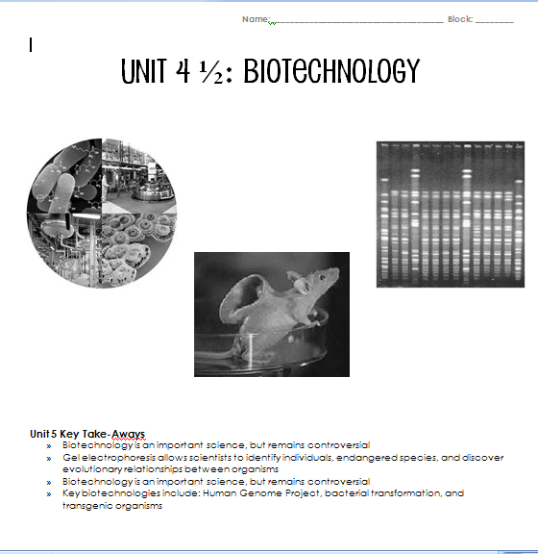

Slide 4
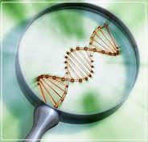
Biotechnology
5 “stations”
9 minutes each
Fill in your notes!

Slide 5
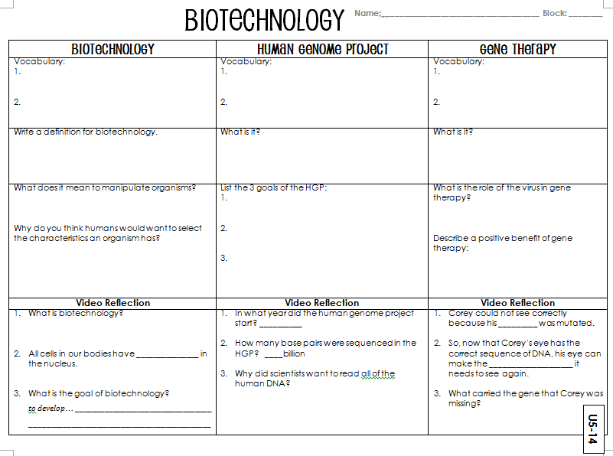

Slide 6
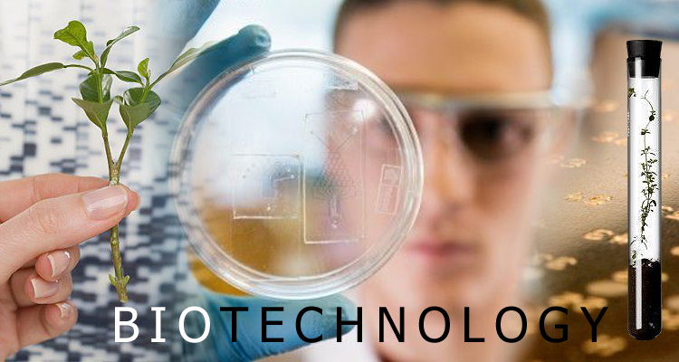

Biotechnology
http://www.youtube.com/watch?v=Wm6_BBS_KE4

Slide 7
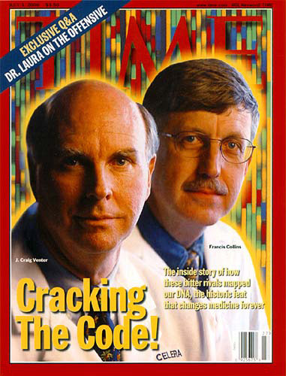
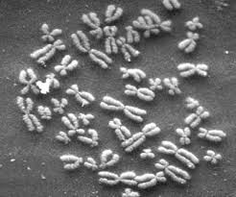
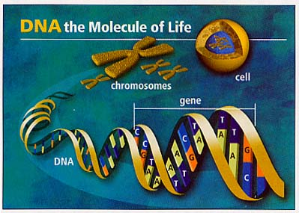
Human Genome Project
https://www.youtube.com/watch?v=N0QZDOcqyO4

Slide 8
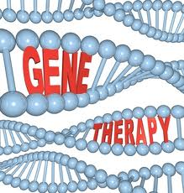
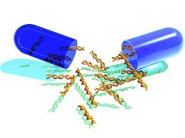
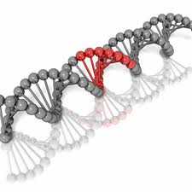
Gene Therapy
https://www.youtube.com/watch?v=H0RvTOF1fEc

Slide 9
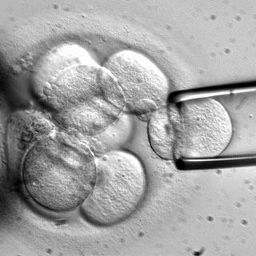
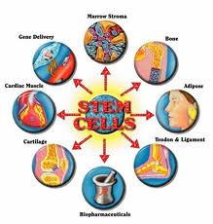
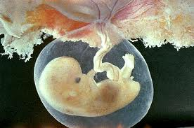
Stem Cell Research
https://www.youtube.com/watch?v=tPulEAryPO0

Slide 10
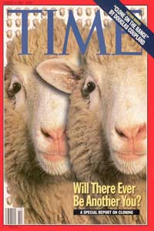
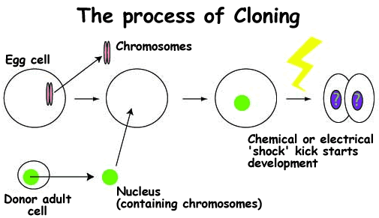
Cloning
https://www.youtube.com/watch?v=EoqBhtwgPmw

Slide 11
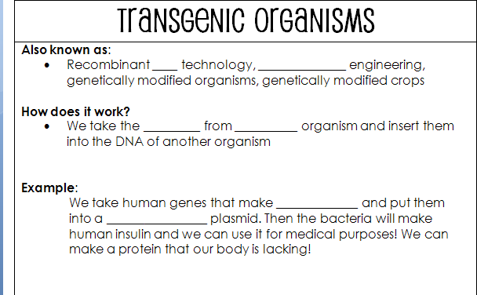
DNA
genetic
genes
one
insulin
bacterial

Slide 12
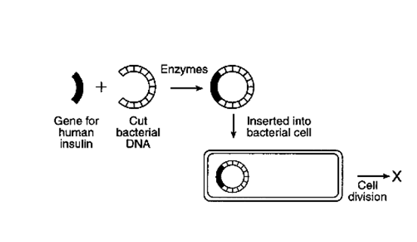
Transgenic organisms

Slide 13
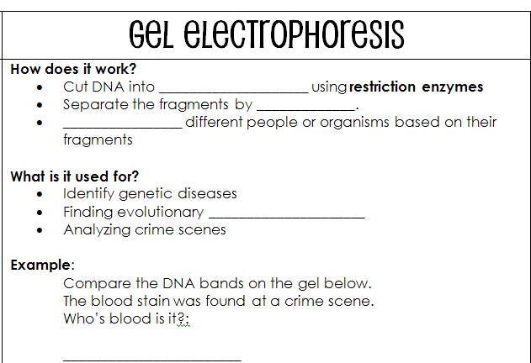
fragments
size
group
relationships

Slide 14
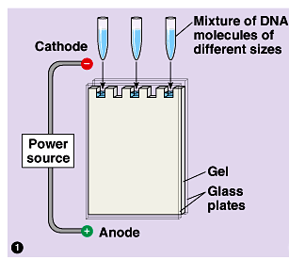
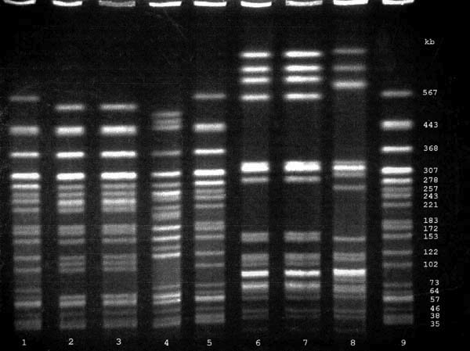

Gel electrophoresis
https://www.youtube.com/watch?v=Wwgs-FjvWlw

Slide 15
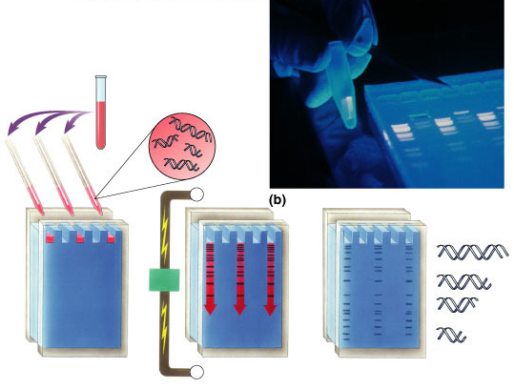
Gel electrophoresis

Slide 16
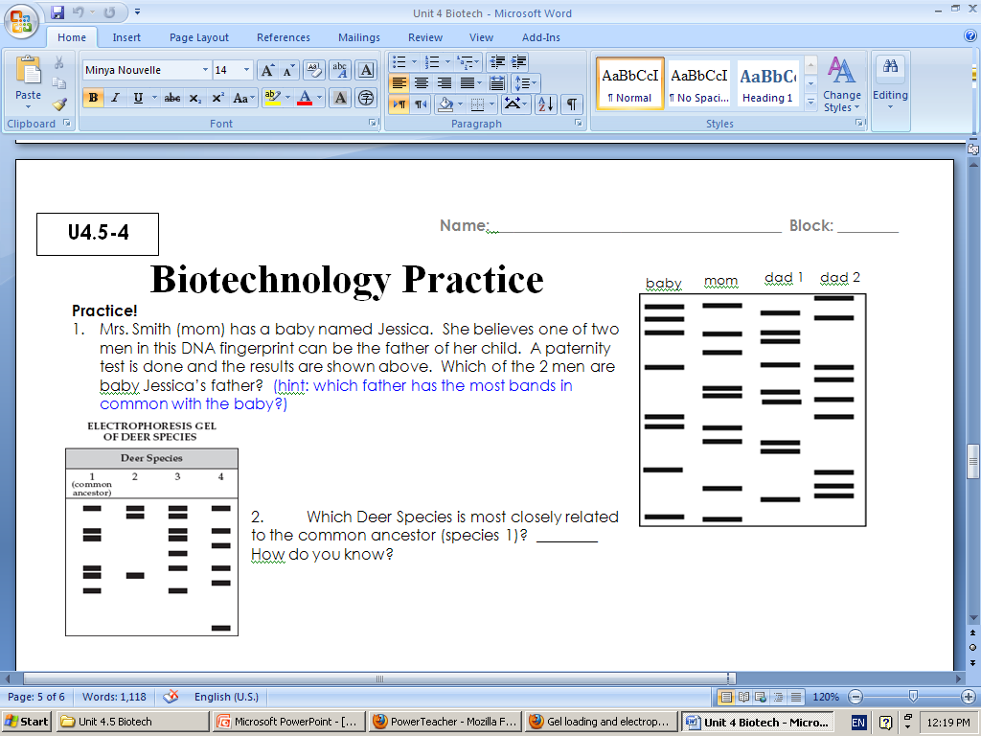
U4-26

Slide 17
Biotechnology advertisement
Choose 1 type of biotechnology
Make an advertisement explaining your technology and why people should use it

Slide 18
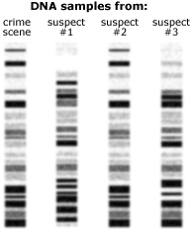
Do Now
What are transgenic organisms?
How are transgenic organisms used in modern medicine? (Hint: think of diabetics)
According to the DNA samples below, which suspect was at the crime scene?
What type of biotechnology
is this?

Slide 19
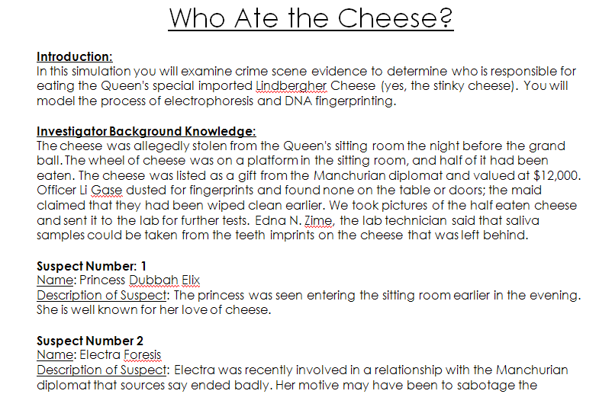
Who at the Cheese

Slide 20
Materials
Handout
Scissors
5 DNA patterns
  Crime scene DNA
  Suspect 1
  Suspect 2
  Suspect 3
  Suspect 4

Slide 21
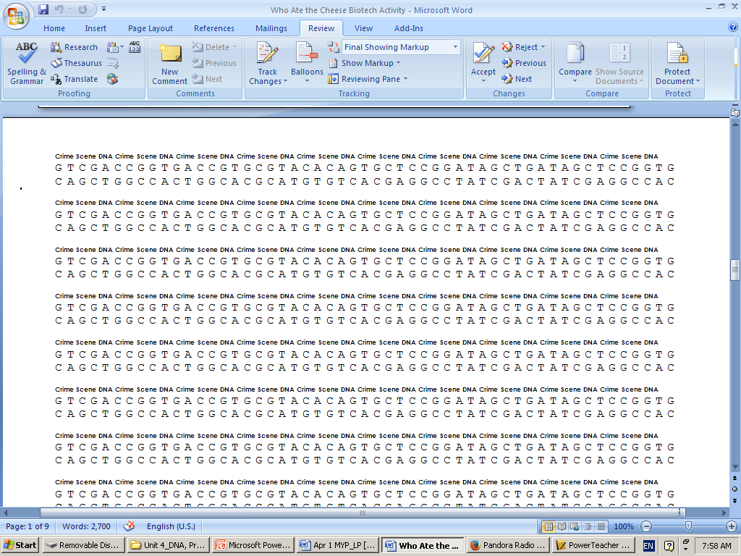

Slide 22
